Slide 1

Faculty of Engineering and Technology
Department of Artificial Intelligence and Data Science
Notes:
This is the title slide for respective colleges/institutions while we retain the DMIHER logo on top always.

Slide 2

PROGRESS PRESENTATION
TOPIC
Arogyabot: Artificial Intelligence Diagnostic Bot using Machine Learning
NAME OF SCHOLAR: Nikhil Pardhi
NAME OF THE SUPERVISOR: Mrs. Shital Hajare
DEPARTMENT OF Artificial Intelligence and Data Science
FACULTY OF ENGINEERING AND TECHNOLOGY, DMIHER (DU), SAWANGI (MEGHE) , WARDHA
DATE :24/09/2025

Slide 3
PROGRESS PRESENTATION OF MINOR PROJECT I

Slide 4
CONTENTS
INTRODUCTION
PRISMA CHART
LITERATURE SURVEY AND RESEARCH GAP ANALYSIS
SUMMARY OF RESEARCH GAP
RESEARCH QUESTION
AIM
OBJECTIVES
METHODOLOGY
COMPLIANCE OF THE LAST PROGRESS PRESENTATION
PROGRESS OF MINOR PROJECT I
RESULTS
CONCLUSION
PUBLICATION/COPYRIGHT/PATENT
REFERENCES

Slide 5
INTRODUTION
Arogyabot is an AI-based chatbot designed to answer medical questions using previously uploaded documents.
It uses machine learning and semantic search to understand and respond accurately.
The system helps users access medical information easily without expert help.
Built to improve health literacy, diagnosis support, and medical document understanding.

Slide 6
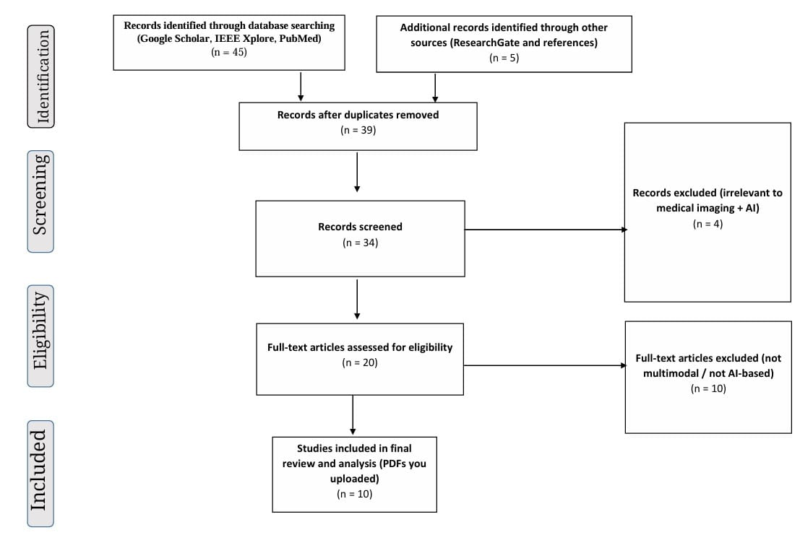
PRISMA CHART

Slide 7
LITERATURE SURVEY
Sr.No | Title of the Article Author Year of publication | Focus of Study, AI Model Used and Sample size | Knowledge Gap | Remarks of the Scholar
1. | Title: miniGPT-Med: Large Language Model as a General Interface for Radiology Diagnosis[1] Year: 2024 | Study Design: Model development and evaluation study AI Model Used: MiniGPT-Med (MiniGPT-v2 + LLaMA2-chat 7B) Sample: MIMIC (114,539 X-rays), NLST (7,625 CT scans), SLAKE (579 images), RSNA (1,218 patients), RadVQA (315 images) | Limited and low-diversity datasets; hallucinations; confusion with implants in images; suboptimal vision encoder performance; lacks clinical validation | Expand datasets; enhance medical terminology understanding; improve interpretability; validate clinically for safe, real-world healthcare integration

Slide 8
LITERATURE SURVEY
Sr.No | Title of the Article Author Year of publication | Focus of Study, AI Model Used and Sample size | Knowledge Gap | Remarks of the Scholar
2. | Title: ECG-Chat: A Large ECG-Language Model for Cardiac Disease Diagnosis[2] Year: 2025 | Study Design: Model development and evaluation study AI Model Used: ECG-Chat (ECG encoder + Vicuna-13B) Sample: MIMIC-IV-ECG (805K), PTB-XL, CPSC2018 datasets; ECG-Instruct dataset (19K diagnosis, 25K dialogue samples) | Lack of real-world instruction-tuning data; feature misalignment; hallucinations; low accuracy in waveforms and rare symptoms; limited to ECG modality | Improve rare symptom diagnosis and waveform accuracy; integrate other modalities (X-Ray, EHR) using advanced medical LLMs for holistic medical record interpretation

Slide 9
LITERATURE SURVEY
Sr.No | Title of the Article Author Year of publication | Focus of Study, AI Model Used and Sample size | Knowledge Gap | Remarks of the Scholar
3. | Title: Revolutionizing Brain Tumor Analysis: A Fusion of ChatGPT and Multi-Modal CNN for Unprecedented Precision[3] Year: 2024 | Study Design: Model development and evaluation study AI Model Used: Multi-Modal CNN + ChatGPT interface Sample: BraTS dataset: 285 MRI scans (210 high-grade, 75 low-grade glioma), 199 training, 86 testing | Tested on only one dataset; limited validation; small-scale clinician evaluation of ChatGPT interface; potential generalizability issues | Test on larger, diverse datasets; optimize CNN architecture; integrate advanced NLP techniques; gather clinician feedback for model refinement and clinical adaptation

Slide 10
LITERATURE SURVEY
Sr.No | Title of the Article Author Year of publication | Focus of Study, AI Model Used and Sample size | Knowledge Gap | Remarks of the Scholar
4. | Title: Optimized deep learning model for comprehensive medical image analysis across multiple modalities[4] Year: 2024 | Study Design: Model development and evaluation study AI Model Used: Optimized Deep Learning (CNN-based) model Sample: Combined dataset from multiple public sources (no exact number specified) covering various imaging modalities | Limited to specific imaging modalities; lacks use of advanced DL techniques (e.g., transformers); generalizability not fully tested | Explore transformer models and capsule networks; adapt to improve accuracy, interpretability, and learning efficiency; validate on diverse datasets for clinical applicability

Slide 11
LITERATURE SURVEY
Sr.No | Title of the Article Author Year of publication | Focus of Study, AI Model Used and Sample size | Knowledge Gap | Remarks of the Scholar
5. | Title: Performance of Artificial Intelligence Chatbots on Ultrasound Examinations: Cross-Sectional Comparative Analysis[5] Year: 2024 | Study Design: Comparative evaluation study AI Model Used: ChatGPT-3.5, ChatGPT-4, Google Bard, Bing Chat Sample: 90 total items (60 reports + 30 test Qs); evaluated by 3 independent physicians | Limited to ultrasound; small sample size; inter-rater differences; single-model limitations for complex cases | Use multiple models for complex problems; combine AI systems for comprehensive analysis; expand study scope across imaging types and larger datasets

Slide 12
SUMMARY OF RESEARCH GAP
Existing chatbots (e.g., Buoy, Ada) mainly rely on user symptoms and past data.
They offer limited support for document-based medical queries.
Most use templated answers and lack deep understanding of new questions.
Gap: No system combines document upload, semantic search, and conversational AI.
Arogyabot fills this gap by offering accurate, real-time answers from medical files.

Slide 13
RESEARCH QUESTION
How can a web-based chatbot using retrieval-augmented vector search accurately and reliably answer medical queries from uploaded documents?

Slide 14
AIM
To develop an AI-powered chatbot that understands and answers user queries using previously uploaded medical documents through machine learning and semantic search.

Slide 15
OBJECTIVES
To break medical documents into readable parts for easy processing
To search and find the most relevant parts using AI and semantic search
To build a chatbot that gives accurate answers based on the given symptoms in text data.

Slide 16
METHODOLOGY
Phase 3
What is a neural network?
Answer
Phase 2
Question Embedding
LLM
Ranked Results
Semantic Search
Phase 1
Chunk of Text(doc1)
Embedding 1
Knowledge Base
Raw PDF files
Knowledge Source (Extracted Data)
Chunk of Text(doc2)
Embedding 2
Chunk of Text(doc3)
Embedding 3
Vector Store FAISS

Slide 17
COMPLIANCE OF LAST PRESENTATION
Sr. No. | Compliance | Action Taken | Outcome
1. | Absent | Met Mentor, Project Co-ordinator, R & D Co-ordinator and finalized the topic | Topic has been finalized . successfully updated on . drive
2. | Speed Up the process | 90% of project is completed | Just minor changes remaining then project is completed
3. | Complete the project | Completed the project | It successfully handles user’s query

Slide 18
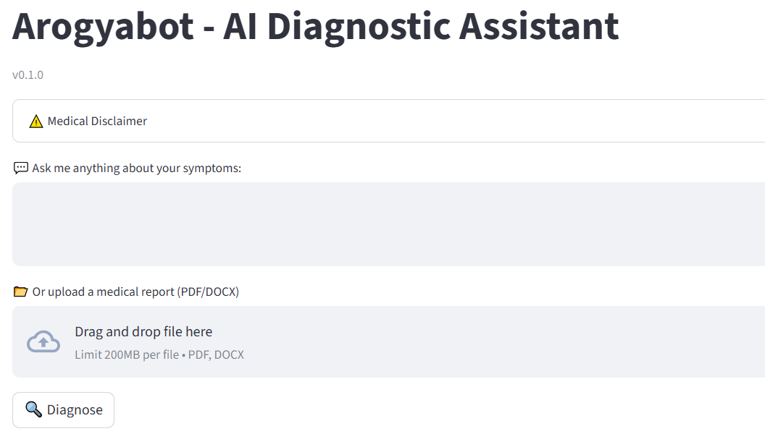
PROGRESS OF MINOR PROJECT I
Phase I Completed: Document parsing, chunking, and embedding using FAISS
Phase II Completed: Semantic search and integration with language model(Mistral)
Phase III Completed: Chatbot UI development with Streamlit
Overall Progress: 100% completed

Slide 19
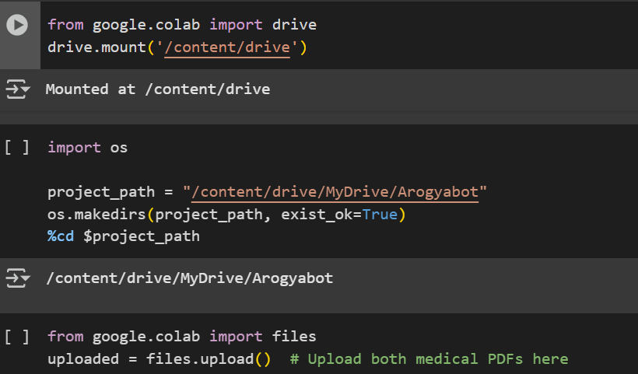
PROGRESS OF MINOR PROJECT- I
Phase - I
Raw PDF files uploaded

Slide 20
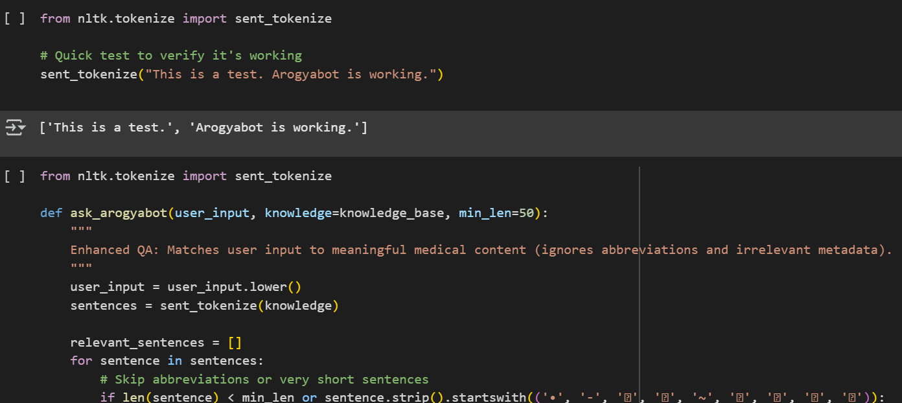
PROGRESS OF MINOR PROJECT I
Phase - I
Divided data into tokens i.e small small chunks

Slide 21
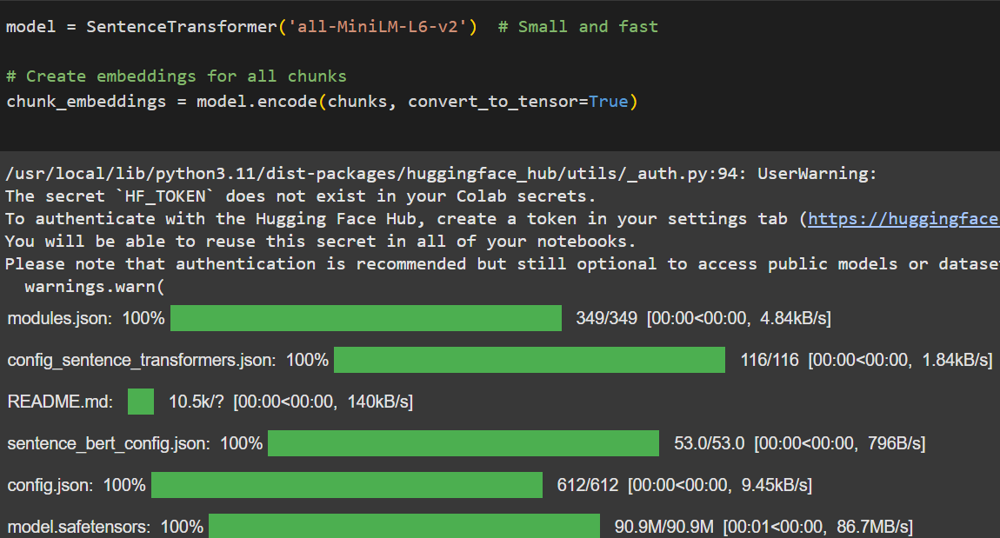
PROGRESS OF MINOR PROJECT I
Phase - I
Used Mistral Ai model from hugging face

Slide 22
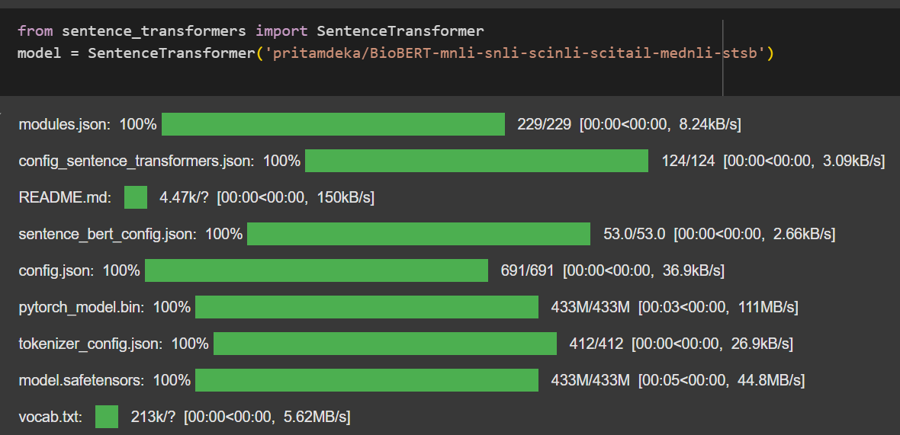
PROGRESS OF MINOR PROJECT I
Phase - I
Used Biobert model from hugging face

Slide 23
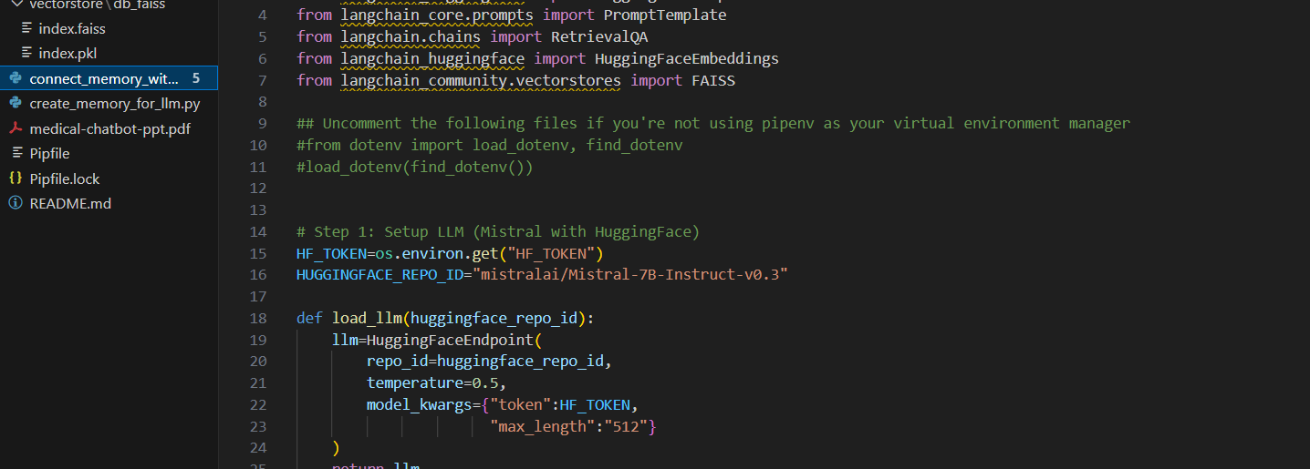
PROGRESS OF MINOR PROJECT I
Phase - II
Connecting memory with Large Language Model

Slide 24
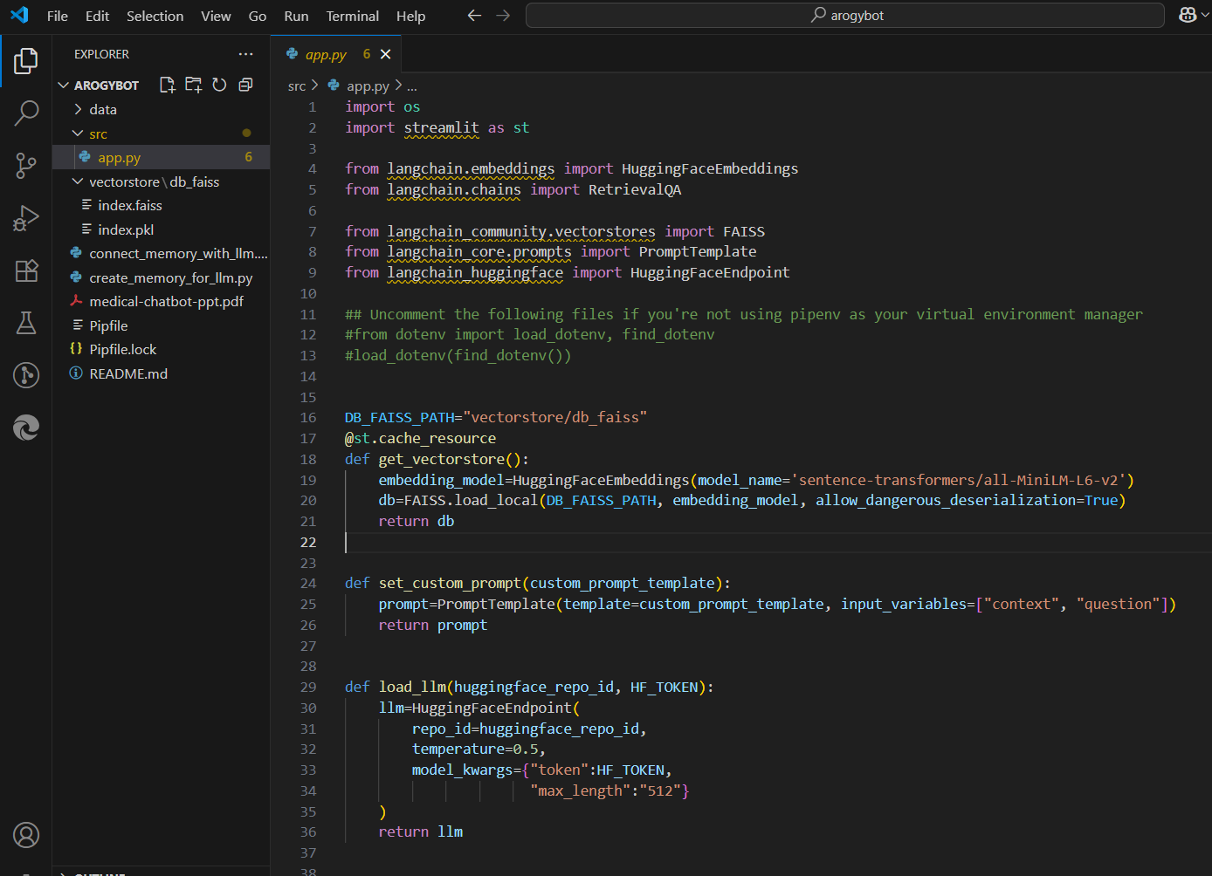
PROGRESS OF MINOR PROJECT I
Phase - II
Entire Flow of Code

Slide 25
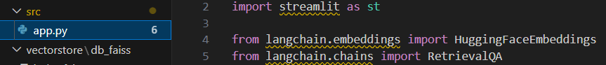
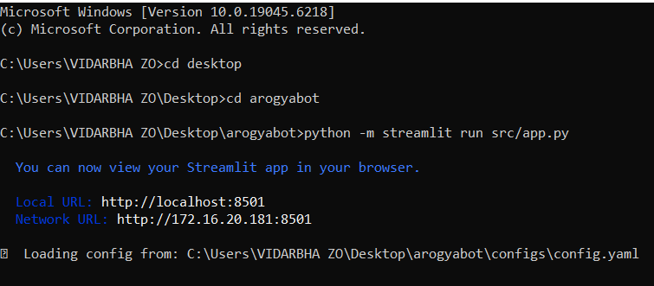
PROGRESS OF MINOR PROJECT I
Phase - III
Creation of a dashboard for chatbot
Commands to run the dashboard

Slide 26
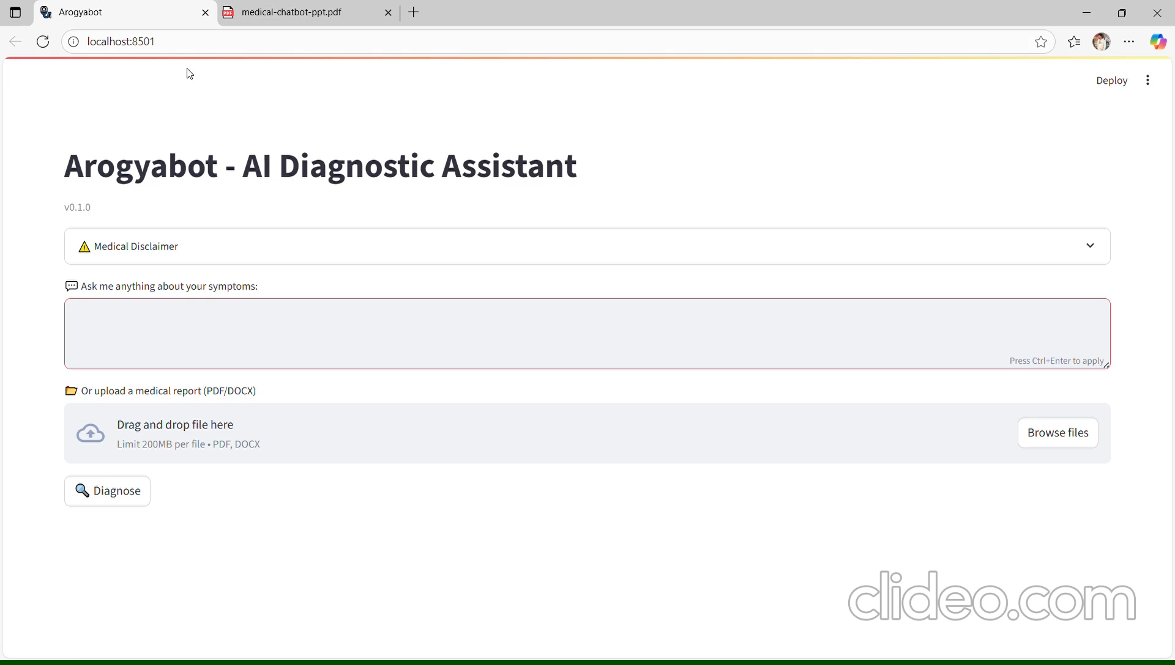
PROGRESS OF MINOR PROJECT I
Phase - III
Dashboard

Slide 27
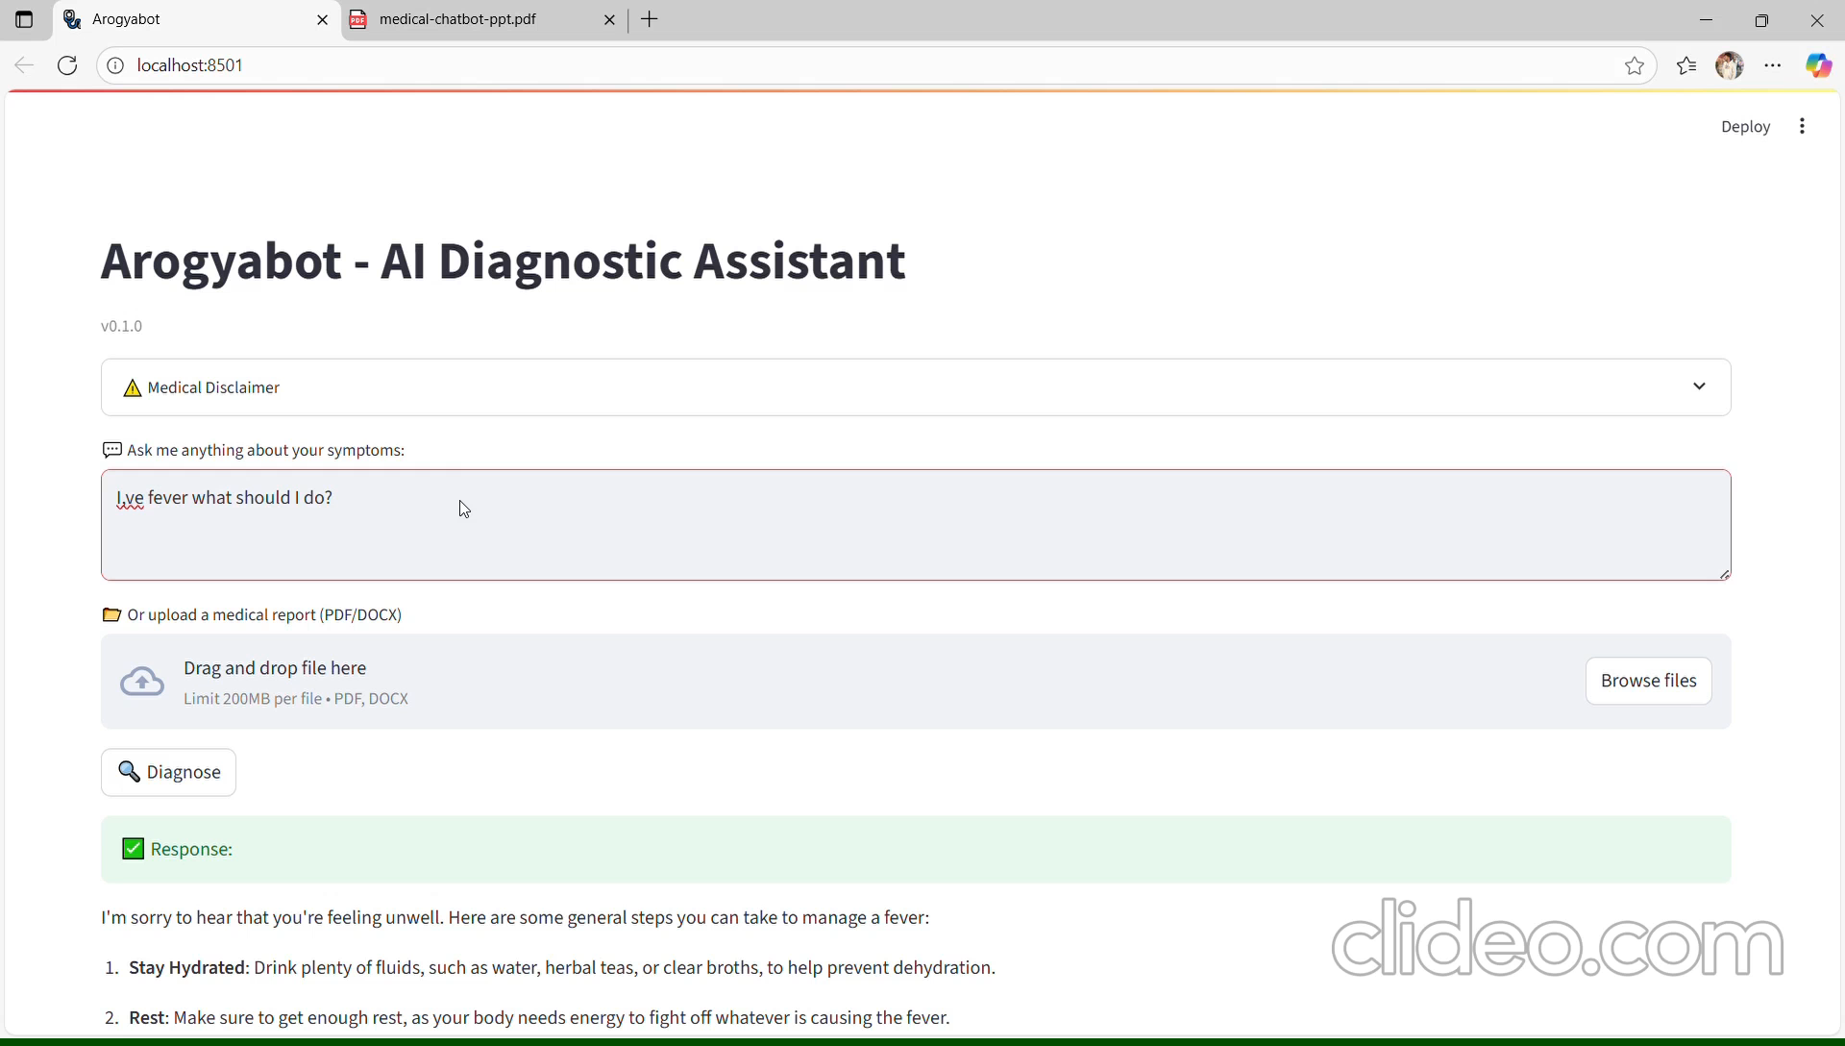
PROGRESS OF MINOR PROJECT I
Phase - III
Dashboard

Slide 28
RESULT
Successfully uploaded and processed medical documents
Generated vector embeddings using FAISS
Semantic search retrieves the most relevant content
Preliminary answers from the model show good accuracy
Chatbot UI setup is completed

Slide 29
CONCLUSION
Arogyabot simplifies access to complex medical content
Combines document parsing, vector search, and AI response
Improves health literacy and supports medical understanding
Modular design allows future expansion and scalability

Slide 30
PUBLICATION/COPYRIGHT/PATENT
Documents Submitted for Copyright

Slide 31
References
[1] Y. Zhao, W. Zhang, Y. Wang, et al., “ECG-Chat: A Large ECG-Language Model for Cardiac Disease Diagnosis,” arXiv preprint arXiv:2405.04610, 2025. [Online]. Available: https://arxiv.org/abs/2405.04610
[2] M. Rawas and R. Samala, “Revolutionizing Brain Tumor Analysis: A Fusion of ChatGPT and Multi-Modal CNN,” Biomedical Signal Processing and Control, vol. 91, p. 105237, 2024. doi: 10.1016/j.bspc.2023.105237
[3] Y. Zhang, X. Chen, S. Zhang, et al., “Performance of AI Chatbots on Ultrasound Examinations,” Insights into Imaging, vol. 15, no. 1, 2025. doi: 10.1186/s13244-024-01630-z
[4] A. Moglia, G. Ferrari, P. P. M. Pomella, et al., “MiniGPT-Pancreas: Advancing Multimodal LLMs for Pancreatic Cancer Classification and Detection,” Scientific Reports, vol. 14, p. 5634, 2024. doi: 10.1038/s41598-024-56801-4
[5] B. S. Mienye, M. T. Ilori, and H. F. Danso, “Deep Convolutional Neural Networks in Medical Image Analysis: A Systematic Review,” Biomedical Signal Processing and Control, vol. 86, p. 104387, 2025. doi: 10.1016/j.bspc.2023.104387

Slide 32
References
[6] H. Alkhaldi, D. W. Li, M. Alazab, and N. Alshurideh, “MiniGPT-Med: Advancing Large Multimodal Language Models in Clinical Diagnosis,” Computers in Biology and Medicine, vol. 173, p. 107682, 2024. doi: 10.1016/j.compbiomed.2024.107682
[7] J. Lee, S. Kim, and Y. Park, “ChatGPT versus Human Radiologists: Comparative Evaluation of Chest X-ray Interpretation,” Radiology: Artificial Intelligence, vol. 7, no. 1, 2025. doi: 10.1148/ryai.220063
[8] A. Ahmed, S. Patel, and L. Deshmukh, “Artificial Intelligence Integration in Radiology Workflow: Enhancing Efficiency and Accuracy,” Journal of Digital Imaging, vol. 37, pp. 123–134, 2024. doi: 10.1007/s10278-024-00856-3
[9] N. Bhatia and R. Verma, “A Hybrid CNN-LSTM Model for ECG Signal Classification,” Computer Methods and Programs in Biomedicine, vol. 234, p. 107556, 2023. doi: 10.1016/j.cmpb.2023.107556
[10] A. Arora, K. Sharma, and P. Banerjee, “Large Language Models in Medical Question Answering: Challenges and Opportunities,” npj Digital Medicine, vol. 6, no. 178, 2023. doi: 10.1038/s41746-023-00999-z

Slide 33
Thank You

